Slide 1




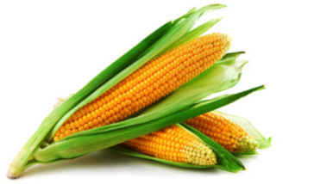
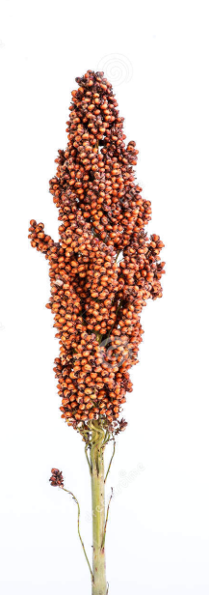
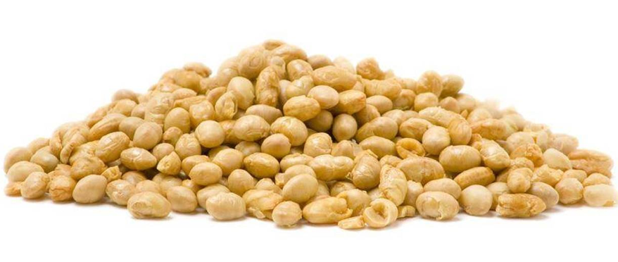
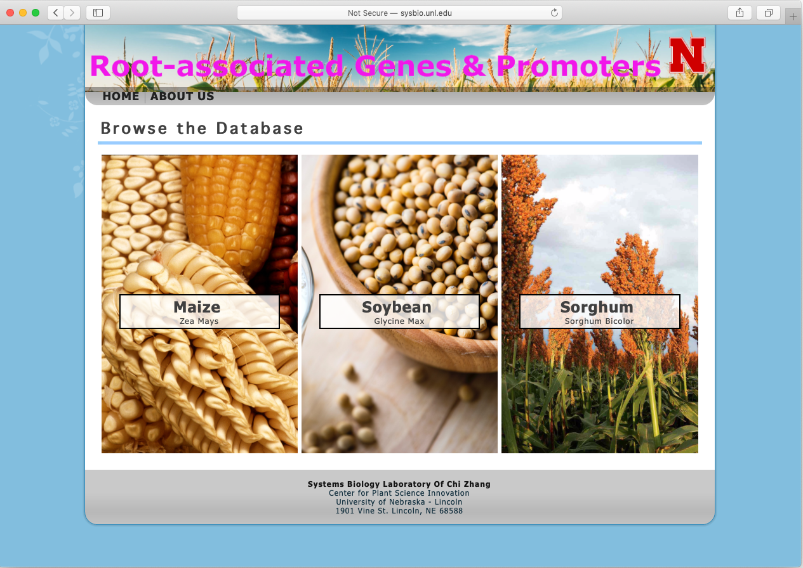
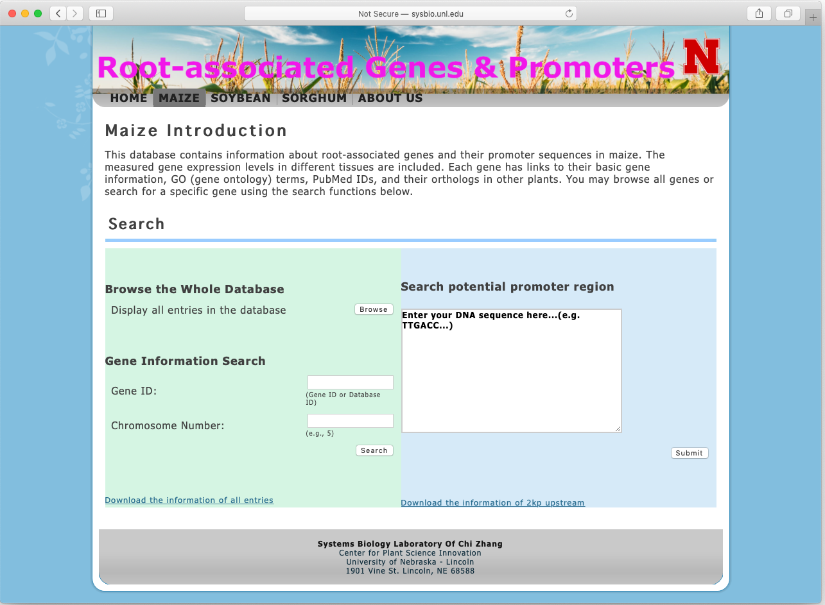
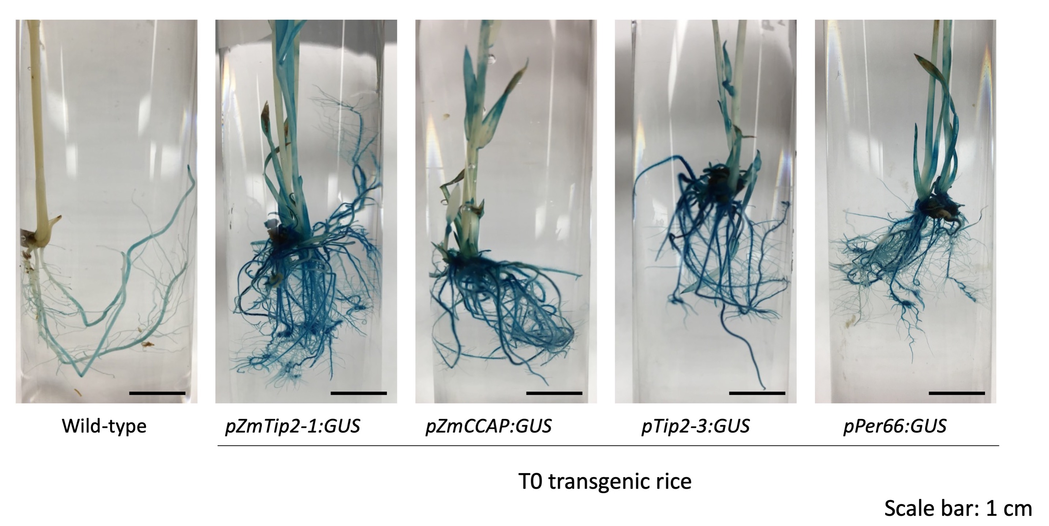
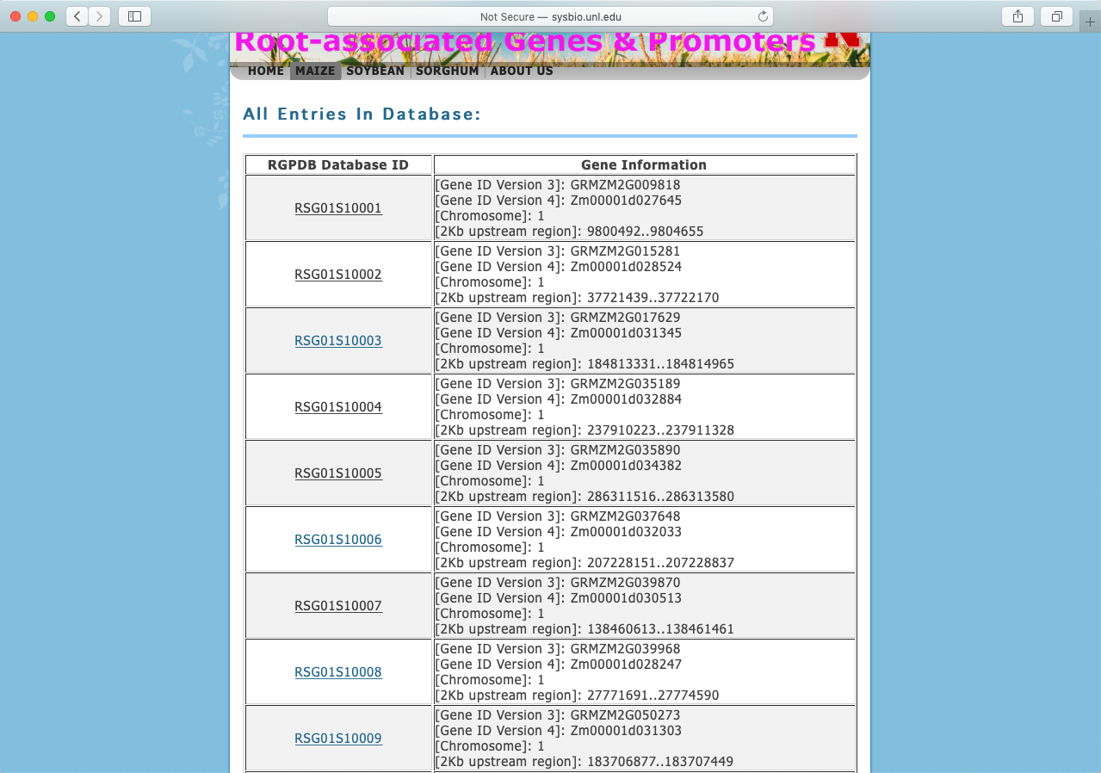
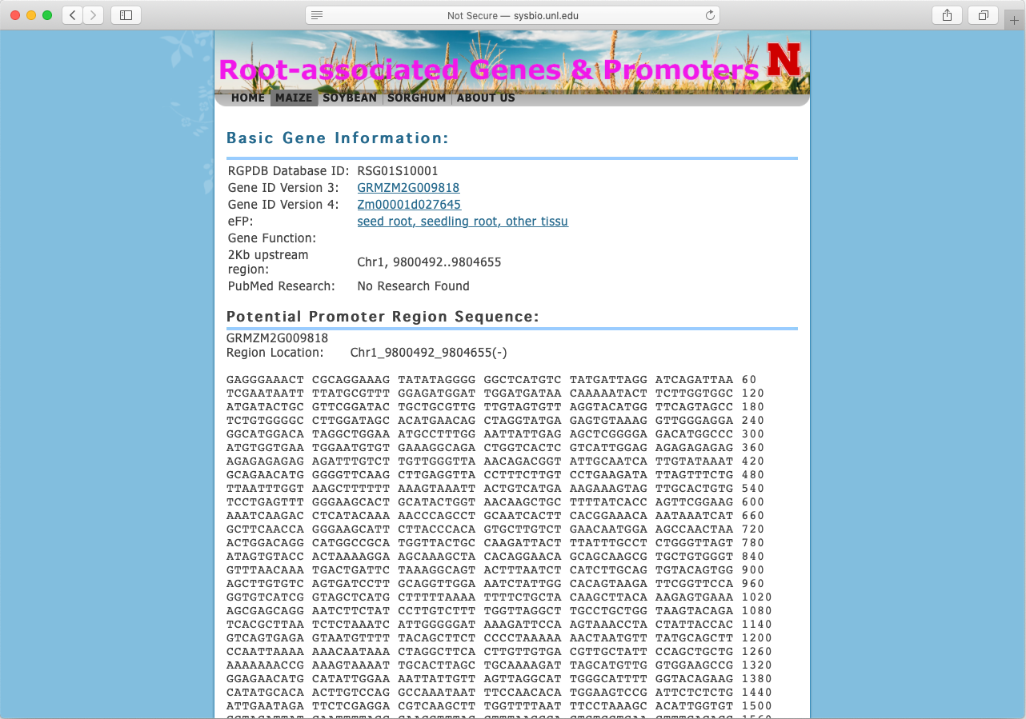
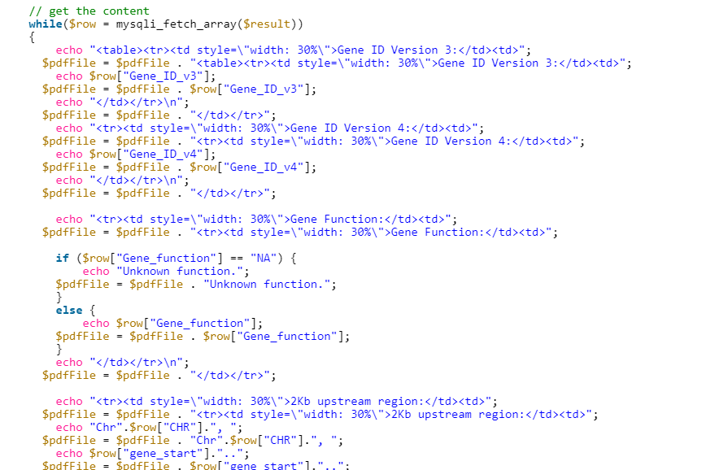
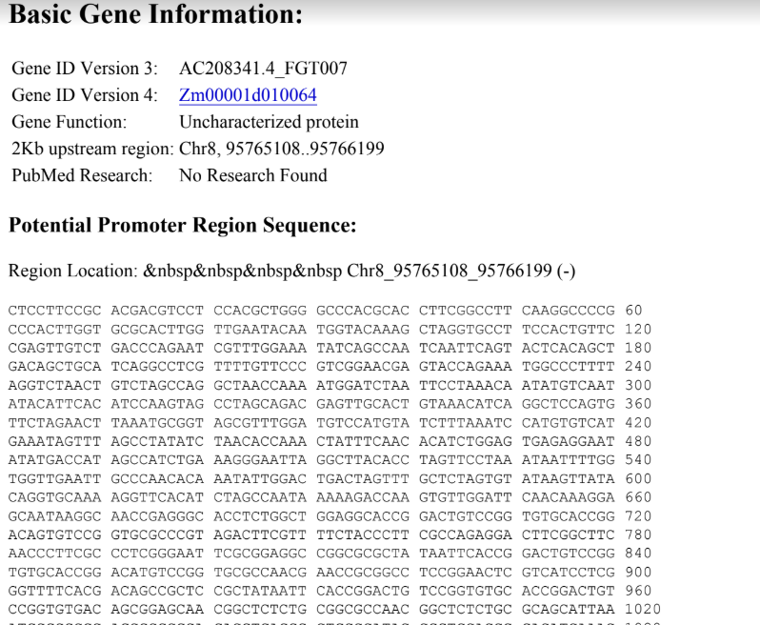
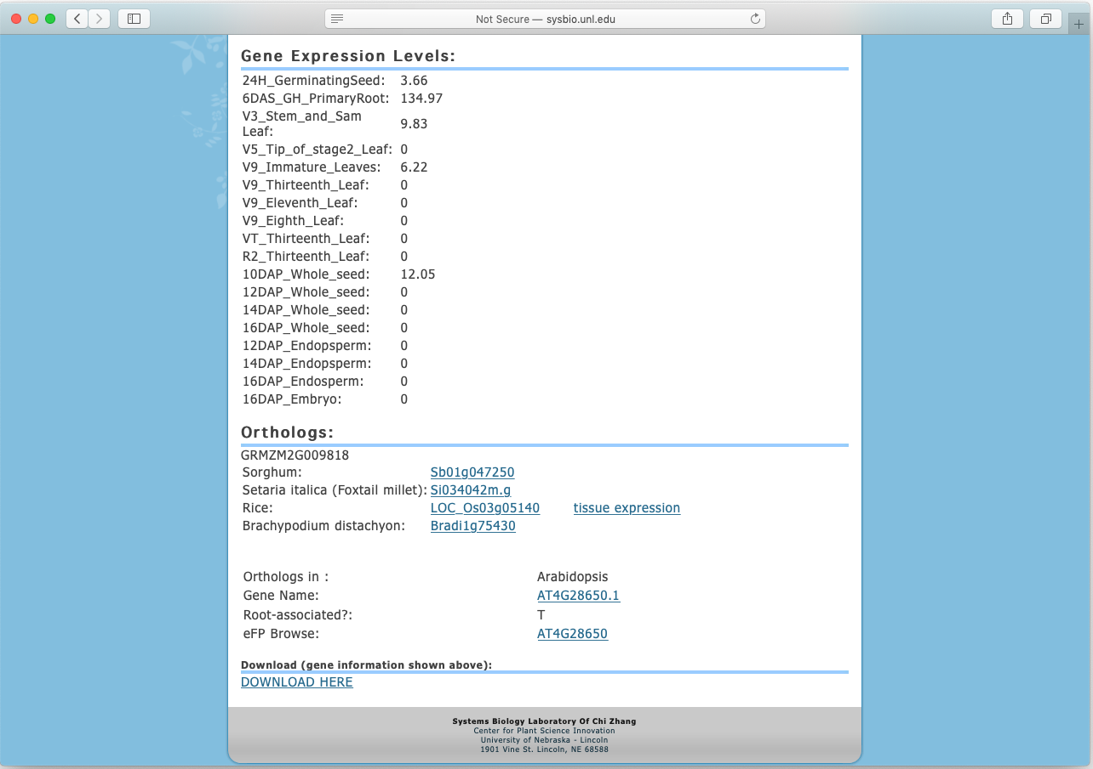
The Database of Root-Associated Genes
and their Promoters in Maize, Sorghum, and Soybean
Gleb Moisseyev, Divith Rajagopal, Kiyoul Park, Kan Liu,
James Schnable, Etsuko N. Moriyama, Edgar B. Cahoon, Chi Zhang
School of Biological Sciences, Department of Biochemistry,
Center of Plant Science Innovation, UNL, Lincoln, NE, 68588, USA
ABSTRACT
- --
Method
Maize
Abstract
Implement all gene expression values into individual arrays
For each of the 592 Maize genes we gave each of the 592 id genes a special id. For example, one gene is titled RS201S492. RS stands for Root Specific. This specific ID allows researchers or observers to find particular genes quicker. This allows researchers to delineate differences between genes. We also found
corresponding orthologs
of Maize between sorghum
, Arabidopsis, and soybean.
Sorghum
For each of the 363 sorghum genes
we gave a specific ID. Once again,
This helps for identification purposes
One gene is titled RS20423S192.
This number was generated through
a PHP iteration process which
Gives each gene a different id.
The 3S is specific for sorghum
Soybean
Root-associated genes are essential to plants as they dictate factors such as the strength of the plant, reproductivity success, etc. However, in status quo studies on roots genes are simply inefficient. To be more specific, currently, there are very few online databases of root-associated genes or gene promoters, which essentially deters root-associated gene studies from being successful. We collected omics data and applied the bioinformatics method to predicted more than 1200 root-associated genes from maize, soybean, and sorghum. For these genes, we constructed an online database that contains information about these genes and their promoter sequences. This online database of these genes contains variant types information of a given gene and the orthologs of the gene. This database creates a pivotal platform capable of stimulating and facilitating further studies on manipulating root growth and development. The database is available at
http://sysbio.unl.edu/RGPDB/
http://crri.unl.edu/RGPDB/
In order to successfully create specific IDS, ortholog matchers, and score functions we needed expertise in the PHP, MYSQL, and HTML. Once that was acquired, we were able to develop several models and functions for our database. For example, for the Soybean Score function, we essentially used a PHP iteration function. First, we implemented gene expression values into individual arrays. We implemented information into arrays through MYSQL databases. We calculated the math the way we did for accuracy purposes. By repeating and iterating our function, the math becomes very accurate decimal wise. The iteration function is also used for giving every maize, soybean, and sorghum gene its own specific id. Each specific ID is given its own different set of letters and numbers. This is mainly done through a randomizer. It is critical that each gene gets its own specific set of letters and numbers for identification purpose. Lastly, we developed an ortholog matcher function. In this function, the orthologs of soybean, sorghum, and maize are compared with each other. If a match is found, it is denoted in our database. This function is essential for our database. An ortholog match displays some similarity between genes. This similarity can show what some root genes are responsible for. Our methodology of this project mainly revolved through our use of PHP, SQL, HTML, Terminal, and Ubuntu software. Luckily, it only took us a few attempts to debug prevalent issues within our system
Set a ‘multiplier’ value of 100
Iterate through all the genes and calculate whether their ‘root’ expression levels are higher than all the other expression levels times the multiplier.
Requirement:
‘Root’ > (multiplier * ‘youngleaf’ & multiplier * ‘flower’ etc.)
If the gene meets the requirement, calculate the ‘score’ by taking ‘root’ expression level and dividing it by the maximum gene expression value of the non-root parts*
Score:
‘Score’ = ‘root’ / max(flower, youngleaf, etc)
*If the maximum is 0, use 1 as the divisor
Introduction
Subtract one from the multiplier and run the iteration again
For soybeans we gave each of the 400 genes a specific ID as well as developing a mathematical model for the soybeans. We also developed
an ortholog matcher which
matches corresponding
orthologs of crops with
each other in order to
find similarity.
Roots are of critical importance for plant biology because they link below and above ground systems and extract water and nutrients from soil. Identification of root-associated genes, their functions, and their interactions can reveal the physiological and molecular mechanisms that regulate the root growth and development and have the potential to improve crop production. There are some databases with information on cis-acting elements that control the transcription initiation by binding corresponding nuclear factors. No databases have been developed specifically for root-associated genes and promoters, and especially for non-Arabidopsis plants. To fulfill the important needs, we collected omics data and using these data, identified root-associated genes and their promoter sequences in maize, soybean, and sorghum. To maximize the value and usability of these types of data for efficient and effective data mining, we developed a web-based comprehensive database of root-associated genes and promoters. Our database, RGPDB, provides detailed information of both root-associated genes and promoters in maize, soybean, and sorghum. Our database, implemented with MySQL, has more than 1200 root-associated genes and their promoters in crops.
Run until multiplier reaches zero or 400 candidate genes have been found (met the requirement)
Figure 1. Soybean Mathematical Model.
Model Provided by Alix Cui
Website Features
What we learned
Our database/website was composed of many integral features that make the RGPDB very user friendly. For example we had a PubMed ID function, Gene Search Function, Home Page functions, ortholog table, homolog table, and etc. Each gene had a list of various genetic information on that gene. The PubMed ID of a gene is given to it when there is an existing publication of a gene. This enables researches to find more information about a gene than what is offered on the current website. We insert a publication link to the gene’s information table, so that a researcher can find a publication link. However, some genes don’t have a publication, so that gene is assigned a PubMed ID as No Research. We also give a gene its respective ortholog and homolog table. An ortholog by definition is “any of two or more homologous gene sequences found in different species related by linear descent”. A homolog by definition is a “gene inherited in two species by a common ancestor”. We made tables of homologs and orthologs for each gene. Here we show a navigation through the maize selection. It works the same way for all three crops.
In conclusion there are many things to take away from this project. From the biological perspective, understanding root genes more is critical for our planet. If researchers understand root genes more, they can understand which root genes have the most effect on growth. Our database allows root gene research to become easier and more feasible. We also learn which root genes lead to higher survival rates, reproductive rates, etc. We learned more about the Root Gene Promoters From the computer science perspective, we learned a lot of web and database development. W3 Schools was critical in giving us expertise in PHP, SQL, HTML. Being involved with this project allowed us to expand both our knowledge of biology and computer science. The main accomplishment we had throughout this program was finishing the RGPDB database. We also gave a presentation to our lab about this project.
Website Tools
In order to build the RGPDB database, we needed to use a variety of coding languages and software. The three coding languages we used were MYSQL, PHP, and HTML. We learned how to use these languages properly through the website W3 Schools. W3 Schools taught us valuable knowledge regarding the coding mechanisms of PHP, HTML, and MYSQL. Furthermore, we used Ubuntu and Terminal Software to input our code. By using these three languages and these two programming soft wares, we were able to successfully code and design our website. Shown below is a screenshot displaying a snippet of php code we coded.
This shown PHP code is part of our gene search function which allows a user to search for a particular root gene and its information on the database. PHP made up majority of our code, however, MySQL & HTML did still play a significant role. PHP was used mainly for our functions such as the gene search function or PubMed ID functions. MySQL was used to store information on the database, as MySql is the main programming language used for databases. HTML was used to supplement PHP. Some functions did require both HTML and PHP. The terminal and Ubuntu software were great for storing code.
References/Acknowledgments
Bardgett, R.D. and Wardle, D.A. (2010) Aboveground-belowground linkages : biotic interactions, ecosystem processes, and global change. Oxford University Press, Oxford.
Birnbaum, K., Shasha, D.E., Wang, J.Y., Jung, J.W., Lambert, G.M., Galbraith, D.W. and Benfey, P.N. (2003) A gene expression map of the Arabidopsis root. Science, 302, 1956-1960.
Kel-Margoulis, O.V., Kel, A.E., Reuter, I., Deineko, I.V. and Wingender, E. (2002) TRANSCompel: a database on composite regulatory elements in eukaryotic genes. Nucleic Acids Res, 30, 332-334.
Makita, Y., Shimada, S., Kawashima, M., Kondou-Kuriyama, T., Toyoda, T. and Matsui, M. (2015) MOROKOSHI: transcriptome database in Sorghum bicolor. Plant Cell Physiol, 56, e6.
Format of Poster and soybean model provided by Alix Cui
Research supported by NSF EPSCoR (Award #: OIA1557417) for CRRI.

